Slide 1

Successful Statistics Learning

Slide 2

Individual Expectations
What you can expect from us:
We will work hard to help you learn.
We will be open, communicate with you, and make efforts to make you comfortable to talk.
We will be polite and respectful.
We will carefully consider your feedback and make appropriate changes.
What we expect from you:
Take active learning as your responsibility.
Engage consistently (statistics courses are cumulative).
Talk to us when you are confused.
Be polite and respectful to the teaching team and classmates (see ‘collaboration skills’).
Try to have fun.
Share your expectations with us:
[DETAILS]

Slide 3
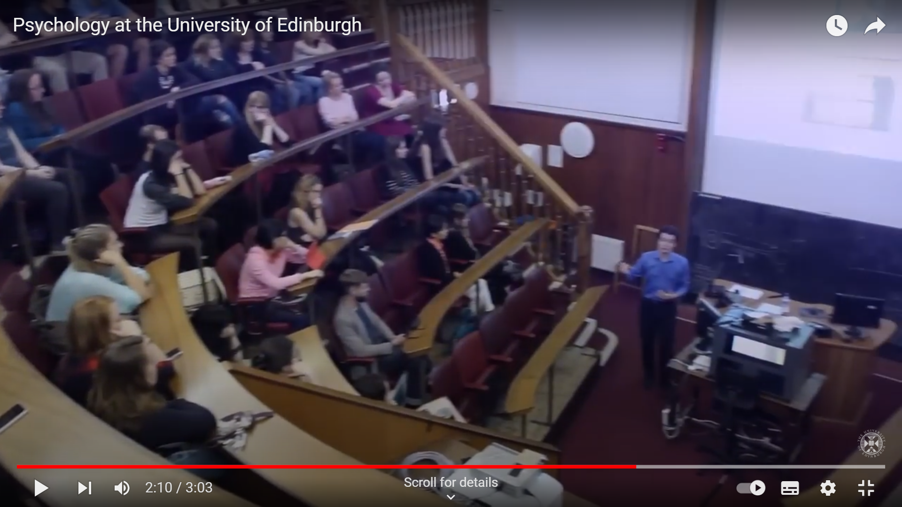



Lectures
Labs / Tutorials
Learning Opportunities
Assessments
Asking Questions
Image credit: https://www.youtube.com/watch?v=vkP00SaSxMU (time 2:08); https://images.app.goo.gl/jo2GAHv4bJHkKo8b7 ; https://www.youthemployment.org.uk/how-to-support-your-students-during-exams/;
https://medium.com/@sajjadali_41293/how-to-find-information-on-the-internet-using-various-platforms-9f8d89bf5525

Slide 4
Lectures
Introduce core concepts and provide demonstrations where applicable
What we expect from you:
BEFORE: Prepare
Find out what the lecture is going to be about.
DURING: Be Active
Put away distractions.
Listen and make notes to help you feel engaged and avoid losing concentration.
AFTER: Reflect & Review
Follow up what you learnt and check clarity and add comments to notes.
Consult [DETAIL, e.g., course overview on Learn].
Get your lecture slides.
Ask questions.
Review lecture recordings to fill any gap and complete readings.
Ask questions.
What you can expect from us:
Weekly course outlines to review connections between past and future learning.
Slides will be available [DETAIL OF THE NUMBER OF HOURS/DAYS] in advance.
Recordings (if available) will be available within [DETAIL OF THE NUMBER OF HOURS/DAYS].

Slide 5
Labs / Tutorials
A place to get hands-on experience and practical support
What we expect from you:
BEFORE: Prepare
Source and read the lab/tutorial materials.
DURING: Be Active
Contribute to class and group discussions / problem solving.
Listen and make notes to help you feel engaged.
AFTER: Reflect & Review
Based on class discussions add to notes.
Answer any pre-assigned questions, and note down any questions you have.
Ask questions.
Think about how the content covered links to and is relevant to the wider content block.
Ask questions.
What you can expect from us:
Practical experience opportunities.
A team of tutors available to answer questions.
Support for issues or questions.
Assistance in finding study partners.

Slide 6
Assessments
Testing your knowledge and understanding
What we expect from you:
What you can expect from us:
Clear expectations on approaching assessments.
Examples of previous student works [DELETE IF NOT APPROPRIATE].
Example assessment questions [DELETE IF NOT APPROPRIATE].
Q&A sessions before and after assessments [DELETE IF NOT APPROPRIATE].
Constructive feedback on strengths and areas for improvement.
BEFORE: Prepare
Check what assessments you have and the criteria.
DURING: Be Active
Read all questions immediately and plan your time accordingly.
Read each question carefully when answering it.
AFTER: Reflect & Review
Don't just focus on numeric grade received - reflect on the feedback.
Review feedback from previous similar assessments, and any example assessments provided by the course.
Note the release and due dates.
Ask any clarification questions.
Ask for clarification on comments if needed for future improvement.
Monitor and reflect on your learning journey. (LINK TO REFLECTION QUIZ)

Slide 7
Asking Questions
Opportunity to clarify / better understand materials
What we expect from you:
BEFORE: Prepare
DURING: Be Active
Take notes.
AFTER: Reflect & Review
Check understanding and comments to notes.
Note down questions, being specific as possible (e.g., refer to specific lecture slide).
Review lecture recordings to fill any gaps post-questions.
If you still don't understand something, ask more questions.
Check how and where you can ask questions.
What you can expect from us:
We welcome all questions.
Clear guidelines on when and how to ask questions.
Office hours: [DETAILS]
Discussion forum: [DETAILS]
Response time: [DETAILS]
Additional support resources: [DETAILS]

Slide 8

Tips

Slide 9

Effective Learning Techniques
Elaborative Interrogation
Self-Explanation
Summarisation
Highlighting / Underlining
Keyword Mnemonic
Imagery for Text
Re-reading
Practice Testing
Distributed Practice
Interleaved Practice
Generate explanations for why facts or concepts are true.
Explain how new information relates to known information or problem-solving steps.
Write summaries of text to be learned.
Mark important portions of materials while reading.
Use keywords and mental imagery to associate verbal materials.
Form mental images of text materials while reading or writing.
Restudy text material after initial reading.
Self-test or take practice tests over materials to be learned.
Spread study activities over time.
Mix different kinds of problems or materials within a single study session.
Source: Dunlosky, J. et al. (2013). Improving students' learning with effective learning techniques: promising directions from cognitive and educational psychology. Psychological Science in the Public Interest: A Journal of the American Psychological Society, 14(1), 4–58.

Slide 10

Effective Time Management
Engage
Take rough notes
Consolidate notes
Add more detail to notes
Structure coherently
Self-test
Ask questions
Continuously test knowledge and understanding
Read
Read assigned papers/ chapters
Be inquisitive - can you find additional reading materials?
Always questioning
Use questions to guide revisions and pre-reviewing.
Prepare
Complete required readings for the upcoming week
Attend
Reflect and review
What done well and struggled?
What do you understand now that you didn’t previously?
Note future action points.
Ask questions (more efficient than struggling)

Slide 11
Effective Time Management
Attend
Engage
Take rough notes
Ask questions
Prepare
Complete required readings for the upcoming week
Read
Read assigned papers/ chapters
Be inquisitive - can you find additional reading materials?
Reflect and Review
What's gone well, where have you struggled?
What do you understand now that you didn’t previously?
Note future action points.
Consolidate Notes
Add more detail to notes
Structure coherently
Always Questioning
Use questions to guide revisions and pre-reviewing.
Ask questions (more efficient than struggling)
Self-Test
Continuously test knowledge and understanding (consider creating flashcards, MCQs, generating your own practice exam questions)

Slide 12

Support

Slide 13

Weekly Support
Edit as appropriate for your course!
Opportunities for course support
Specific support for your course/module
Office hours: [DETAILS]
Discussion forum: [DETAILS]
Opportunities for general academic & pastoral support
General academic advice about your time in University​
[Personal Tutor/Academic Advisor DETAILS]​
Wellbeing advice​
[Wellbeing advisor]​
[Listening service]​
[Counselling service]​
[Other – please add details]

Slide 14
Wider Support & Community
Edit as appropriate for your institution/location!
University Based
Extra-curricular activities
[DETAILS]
Experiential Learning
[DETAILS]
Pre-existed community
[DETAILS]
Outside University Community​
Opportunities available in a non-University settings
[DETAILS]

